Slide 1
“Achieving mental wellness through
SOCIAL connections”
Judge Elizabeth G. Rice
Marie A. Borland, Esq.
Daniel T. Lukasik, Esq.
The Florida Bar Young Lawyers Division
Webinar – December 19, 2018

Slide 2
objectives
Identify disturbing trends regarding mental health in the legal profession.
Reveal how loneliness and isolation play a significant role in these trends.
Discuss skills for building social connections and supportive work environments.

Slide 3
Myths
Myth: Mental illness is not real and cannot be treated.
Fact: Mental disorders, like other health conditions such as asthma, diabetes and cancer, are diagnosable and treatable.
-Surgeon General’s Report on Mental Health

Slide 4
Myths - CONTINUED
Myth: Individuals who suffer from mental illness are unable to participate in society in a meaningful way.
Fact: Many of the greatest contributors to society and its culture had diagnosable mental health conditions.
-Abraham Lincoln, Winston Churchill, Leo Tolstoy, Tennessee Williams, Ernest Hemingway, Sir Isaac Newton, Ludwig von Beethoven, Michelangelo, etc.

Slide 5
Statistics – what we know
Our country is experiencing a mental health crisis of epidemic proportions.

Slide 6
Statistics – What We Know
Approximately 1 in 4 adults and youth in the United States experience mental health challenges in a given year.
Yet, less than 1/2 of those individuals receive mental health services.

Slide 7
Statistics – What We Know
80-90% of people who seek mental health treatment see improvement in their symptoms.

Slide 8
STATISTICS – WHAT WE KNOW
Stereotypes and stigma are the greatest barriers preventing people from seeking help.

Slide 9
Statistics – What We Know
A recent ABA Study revealed that 61% of attorneys surveyed had struggled with depression at some point in their legal careers.
-ABA Commission on Lawyer Assistance Programs and the Hazelden Betty Ford Foundation 2016 Study.

Slide 10
Statistics – What We Know
The study also revealed that 28% of lawyers had struggled with some kind of depression in the past 12 months of the survey.
-“Why We Need to Talk About Lawyers’ Mental Health Now” at lawyerswithddepression.com (citing ABA Commission on Lawyer Assistance Programs and the Hazelden Betty Ford Foundation 2016 Study).

Slide 11
Statistics – What We Know
That is four times the rate found in the general population and ‟truly an epidemic.”
-“Why We Need to Talk About Lawyers’ Mental Health Now” at lawyerswithddepression.com (citing ABA Commission on Lawyer Assistance Programs and the Hazelden Betty Ford Foundation 2016 Study).

Slide 12
Statistics – What We Know
‟The Florida Bar’s own data raises similar concerns. In 2015, a membership survey found that 33% of Florida lawyers saw high stress as a significant challenge while 32% of respondents said balancing work and family life was a significant challenge.”
-“Mental Health: The Issue of Our Time,” by Michael J. Higer, The Florida Bar Journal, Vol. 92 No. 4 (April 2018).

Slide 13
Statistics – What We Know
A recent survey revealed that law students likewise are struggling with mental health issues at alarming percentages:
  -Anxiety - 37%
  -Depression - 17%
  -Suicidal Thoughts - 21%
-“Suffering in Silence: The Survey of Law Student Well-Being and the Reluctance of Law Students to Seek Help for Substance Use and Mental Concerns,” Jerome M. Organ, David B. Jaffe, and Katherine M. Bender, Ph.D., Journal of Legal Education, Vol 66, No. 1 (Autumn 2016).

Slide 14
Statistics – What We Know
Tragically, lawyers have among the highest rates of suicide across all U.S. occupations.
-“As Attorney Suicides Mount, a Survivor Speaks Out,” by Meghan Tribe, Law.com November 12, 2018 (originally published in The American Lawyer (/americanlawyer).

Slide 15
Statistics – What We Know
According to the U.S. Centers for Disease Control and Prevention, the legal industry had the 11th-highest incidence of suicide among professions in 2012.
-U.S. Centers for Disease Control and Prevention 2012 Analysis.

Slide 16
Statistics – What We Know
A recent survey on Mental Health and Substance Abuse by ALM Intelligence found that more than 86% of law firm leaders said that depression occurred in their firms and over 93% said the same for anxiety.
-“Why We Need to Talk About Lawyers’ Mental Health Now” at lawyerswithddepression.com (citing ABA Commission on Lawyer Assistance Programs and the Hazelden Betty Ford Foundation 2016 Study).

Slide 17
Statistics – What you may not Know
Former U.S. Surgeon General Vivik Murthy has recently declared that the United States is experiencing an epidemic of loneliness.
-“What You Need to Know About the Loneliness Epidemic,” Psychology Today posting July 12, 2018.

Slide 18
Statistics – loneliness
Only 53% of Americans say they have meaningful, daily face-to-face social interactions, including an extended conversation with a friend or spending quality time with family.
-“Nearly Half of Americans Report Feeling Alone,” Quentin Fottrell MarketWatch.com published October 10, 2018 (citing Cigna Loneliness Index).

Slide 19
Statistics – loneliness
A recent survey of 20,000 adults ages 18 year and older exploring the impact of loneliness in the U.S. by insurance company Cigna, in partnership with market research firm, Ipsos, revealed that most American adults are considered lonely.
-“New Cigna Study Reveals Loneliness at Epidemic Levels in America,” Cigna Newsroom May 1, 2018.

Slide 20
Statistics – loneliness
2 in 5 Americans sometimes or always feel that their relationships are not meaningful and that they are isolated from others.
1 in 5 Americans report they rarely or never feel close to people or feel there are people they can talk to.
-“New Cigna Study Reveals Loneliness at Epidemic Levels in America,” Cigna Newsroom May 1, 2018.

Slide 21
Statistics – loneliness
According to a recent study published in the Harvard Business Review, lawyers, doctors, and engineers were the occupations reporting the highest levels of loneliness.

Slide 22
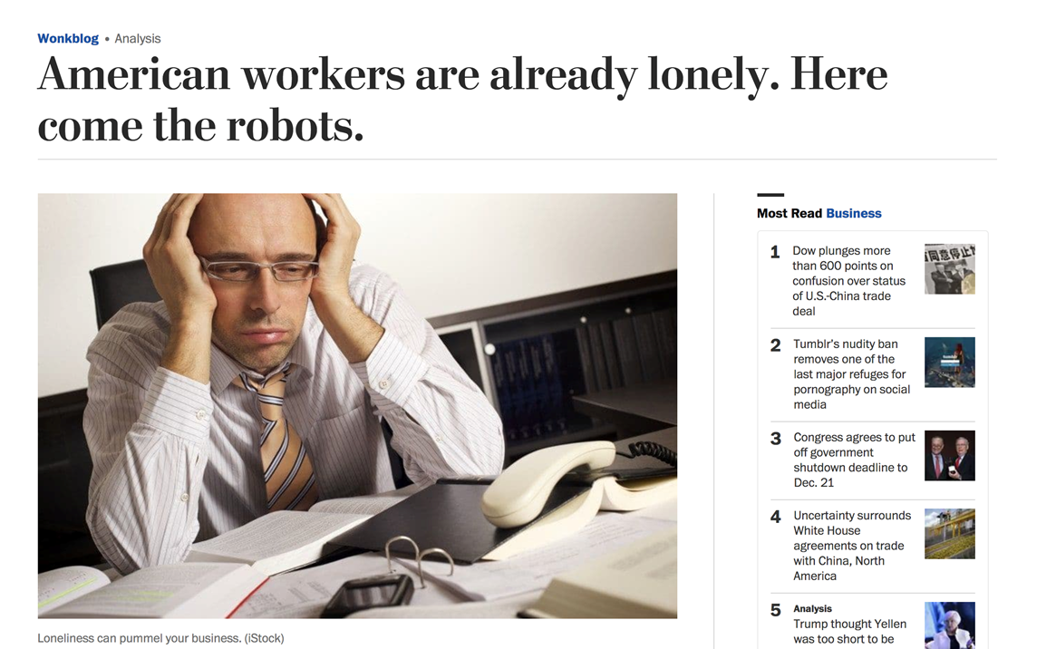
Statistics – loneliness

Slide 23
WHAT CAN WE DO?
So what can we do to help stem the tide of this epidemic of loneliness and reach a state of mental wellness?

Slide 24
support and social connections
•Relationships and Social Networks
•Individual, Family & Community Responsibilities
•Peers and Allies

Slide 25
building social connections
•Relationships and Social Networks-
An important factor in building social connections is the presence of people who offer hope, support, and encouragement.

Slide 26
building social connections
•Individual, Family & Community Strengths and Responsibilities-
All of these resources serve as a supportive foundation for mental wellness.

Slide 27
building social connections
•Peers and Allies-
Peers and allies play an invaluable role in eliminating isolation and promoting mental wellness.

Slide 28
building social connections
•Science shows us that what is most important in maintaining mental wellness and happiness is the relationships we cultivate, not the achievements we accumulate.

Slide 29
building social connections
•Why are social connections important?
-People who have regular, meaningful, in-person interactions (i.e., relationships), are better equipped to achieve overall mental wellness.

Slide 30
Building social connections
What do we do when confronted with a family member, friend, or co-worker who is facing a mental health challenge?
We recommend to respond from a point of ‟LOVE.”

Slide 31
Building social connections
​The #4LOVEPromises initiative was created to promote peer support, social connections, and mental wellness through four healthy and supportive communication skills.

Slide 32
Building social connections
L - Listen
O - Observe
V - Validate
E - Empower

Slide 33
Building social connections – “listen”
Listen - A peer makes eye contact (yes, put down the cell phone) and shows a genuine interest in what is being communicated.

Slide 34
Building social connections – “listen”
A peer listens without interruption and judgment.

Slide 35
Building social connections – “listen”
A peer is an active listener who repeats or rephrases what he or she has heard to confirm the understanding of both parties.

Slide 36
Building social connections – “listen”
A peer attempts to have an open mind as to what is being communicated.

Slide 37
Building social connections – “listen”
A peer shows empathy for what the other person has to say.

Slide 38
Building social connections – “listen”
So what is empathy?

Slide 39
Building social connections – “listen”
Empathy is the ability to share in another’s emotions, thoughts, or feelings.
Empathy is NOT sympathy!

Slide 40

BUILDING SOCIAL CONNECTIONS – “LISTEN”

Slide 41
Building social connections – “listen”
A peer avoids cliché statements like, “I know exactly how you feel.”

Slide 42
Building social connections – “listen”
A peer communicates that he or she genuinely cares and asks how he or she can help.

Slide 43
Building social connections – “listen”
A peer makes suitable suggestions IF the person asks for input, makes suitable suggestions.

Slide 44
Building social connections – “listen”
A peer treats what is shared with respect and confidentiality, unless disclosure is necessary to protect the safety of the speaker or someone else.

Slide 45
Building social connections – “Observe”
Observe - A peer is willing to turn away from technology and pay genuine and close attention to his or her colleague, friend, or family member.

Slide 46
Building social connections – “Observe”
A peer notices when a colleague, friend, or family member is not acting like his or her usual or former self.
So what are some of the signs a peer may notice and observe?

Slide 47
Building social connections – “Observe”
The peer’s colleague, friend, or family member is …
-having trouble concentrating or following through on plans
-isolating or withdrawing from other people

Slide 48
Building social connections – “Observe”
The peer’s colleague, friend, or family member is …
-losing interest in activities or hobbies
-missing work

Slide 49
Building social connections – “Observe”
The peer’s colleague, friend, or family member is …
-having very low energy or too much energy
-exhibiting unusual irritation or anger

Slide 50
Building social connections – “Observe”
If a peer observes any of these behaviors, the peer communicates that he or she …
-is concerned
-would like to listen, in confidence
-would like to help

Slide 51
Building social connections – “validate”
Validation - What is validation?

Slide 52
Building social connections – “validate”
Validation is the recognition and acceptance of another person’s thoughts, feelings, sensations, and behaviors as understandable.

Slide 53
Building social connections – “validate”
Validation does NOT mean agreeing or approving.
Validation communicates that the relationship is important and solid, even if the peer disagrees on the issue.

Slide 54
Building social connections – “validate”
So how do we validate?

Slide 55
Building social connections – “validate”
A peer validates his or her colleague, friend, or family member by …
-acknowledging that the person’s thoughts, feelings, and actions are understandable, and
-trying to understand the person’s perspective, even if the peer doesn’t agree with what is being said or done.

Slide 56
Building social connections – “validate”
Learning to validate effectively takes practice!

Slide 57

Building social connections – “validate”

Slide 58
Building social connections – “validate”
What Not to Say
“You seem depressed.”
“Snap out of it.”
Say Instead
“I see you’re not your usual self.”
“Do you want to talk about it?”

Slide 59
Building social connections – “validate”
What Not to Say
“I know exactly what you’re going through.”
“Think positive.”
Say Instead
“It’s hard for me to understand exactly what you’re going through, but I can see you’re having a tough time.”
“It’s OK to ask for help.”

Slide 60
Building social connections – “empower”
Empower - To “empower” is to make someone stronger and more confident, especially in controlling the circumstances of their life.

Slide 61
Building social connections – “empower”
It is important to understand the difference between empowering and enabling.

Slide 62
Building social connections – “empower”
Enabling is doing for others what they can do for themselves.
Empowering is encouraging and guiding others so they have the power to control their own decisions.

Slide 63
Building social connections – “empower”
A peer empowers by encouraging his or her colleague, friend, or family member to take control of and change their circumstances.

Slide 64
Building social connections – “empower”
A peer listens carefully to the words used by their colleague, friend, or family member to identify the person’s strengths and positive qualities.

Slide 65
Building social connections – “empower”
A peer then empowers by pointing out strengths and positive qualities supported by examples of things the person has said (but please, no “at leasts”).

Slide 66
Building social connections – “empower”
A peer can empower by praising his or her colleague, friend, or family member on his or her progress, no matter how small it is.

Slide 67
Building social connections – “empower”
A peer also can empower simply by smiling and inquiring about the person’s well-being.

Slide 68
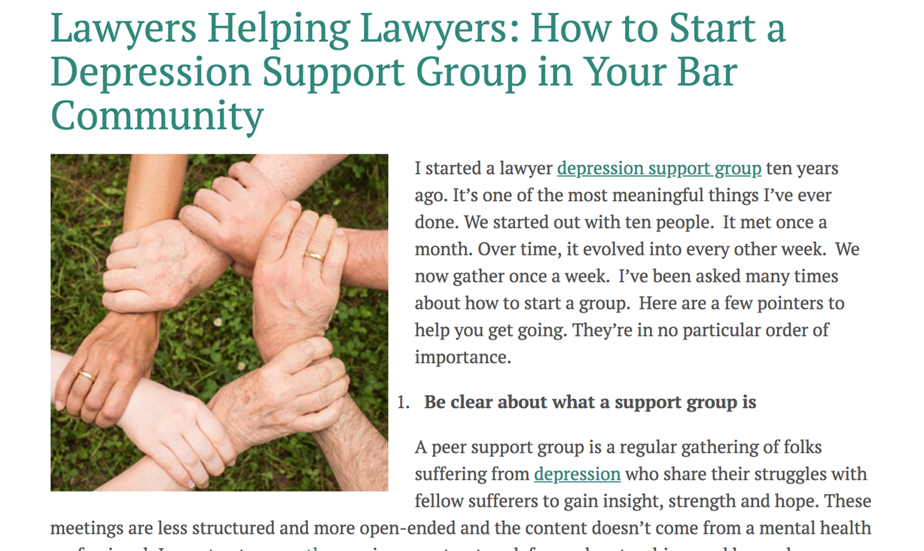
Building social connections – support groups

Slide 69
Building social connections – support groups
Confidential
Everyone there is a lawyer.
Everyone there struggles with depression.
You are not alone.

Slide 70

“ACHIEVING MENTAL WELLNESS THROUGH
SOCIAL CONNECTIONS”

Slide 71
“ACHIEVING MENTAL WELLNESS THROUGH
SOCIAL CONNECTIONS”
Judge Elizabeth G. Rice
riceeg@fljud13.org / 813.272.6994
Marie A. Borland, Esq.
marie.borland@hwhlaw.com / 813.221.3900
Dan Lukasik, Esq.
www.lawyerswithdepression.com / 716.885.1300

