Slide 1
Spirituality for Lawyers
A Game Plan for a Profession
that is Silently Suffering
Samir Ghia, Esq.
May 29, 2019
The Florida Bar

Slide 2

Overview
Why you’re here: what I think I know about you
How we got here: genesis & challenge of the webinar
Theory: Spirituality is the Solution to the Problem
Why this matters / What’s the impact
Spirituality Tools & Strategies
Conclusion

Slide 3
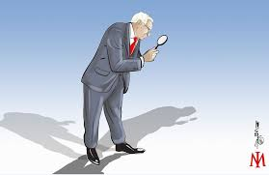



Why You’re Here
Curious
  What do spirituality and lawyers have to do with each other?
  What could this possibly be about?
Cynical / Skeptical
Self-recognition
  In the title
  In the subtitle
  The truth of who you are

Slide 4
The Genesis

Slide 5
Personal Energy Management for Lawyers
How to Kill it at Your Law Firm
(Without It Killing You)
The Florida Bar
1 General CLE Credit
By: Samir Ghia, Esq.
May 2, 2018

Slide 6
ABOUT THIS WEBINAR
PERSONAL ENERGY MANAGEMENT
WHY: THE KEY TO ACHIEVING YOUR GOALS
WHAT:
  SLEEP
  MOVEMENT
  NUTRITION
  MEDITATION
HOW: TO MAKE A DIFFERENCE TODAY

Slide 7
ABOUT THIS WEBINAR
PERSONAL ENERGY MANAGEMENT
WHY: THE KEY TO ACHIEVING YOUR GOALS
WHAT:
  SLEEP
  MOVEMENT
  NUTRITION
  MEDITATION
HOW: TO MAKE A DIFFERENCE TODAY

Slide 8
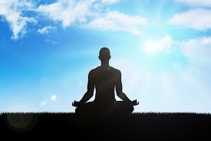

Meditation: INTRO
Ancient Practice
Not "Religious"
You can do this; it's accessible
It's THE most powerful mind training tool on the planet
More important Now than Ever before (distraction, societal discourse, technology, etc.)

Slide 9
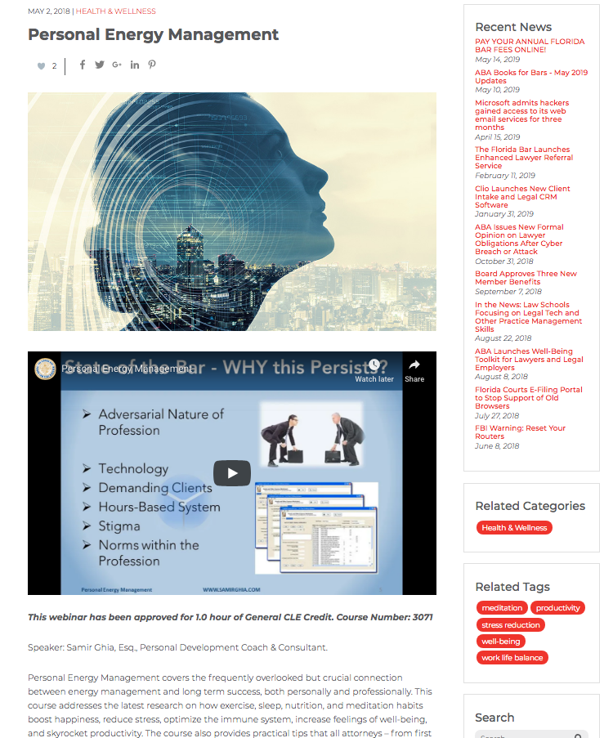

Previous Webinar
Free
1 CLE Credit
https://www.legalfuel.com/personal-energy-management/

Slide 10
The Challenge

Slide 11
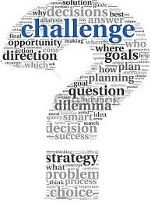




Challenge & Growth
Me
You
The Bar
The Profession

Slide 12
Spirituality for Lawyers
A Game Plan for a Profession
that is Silently Suffering
Samir Ghia, Esq.
May 29, 2019
The Florida Bar

Slide 13
The Theory

Slide 14
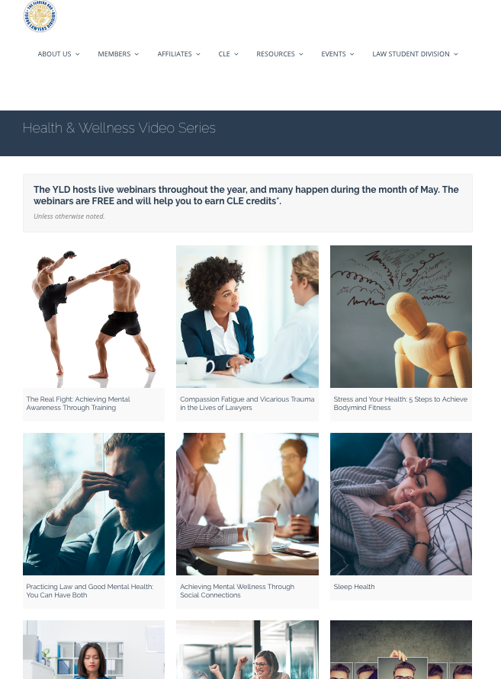
What We Know
“Spiritual” & “Lawyer” don’t usually go together
We know the profession is suffering
Starting to hear solutions and they are all great, correct, and helpful
But…

Slide 15

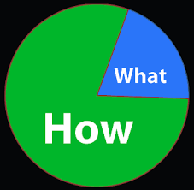
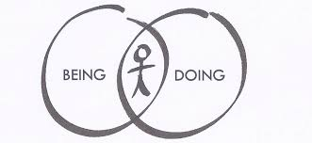
But Something is Missing
All of the solutions are focused around the WHAT (including my presentation last year)
What about the HOW?
What about the BEING
behind the DOING
Hence, SPIRITUALITY

Slide 16
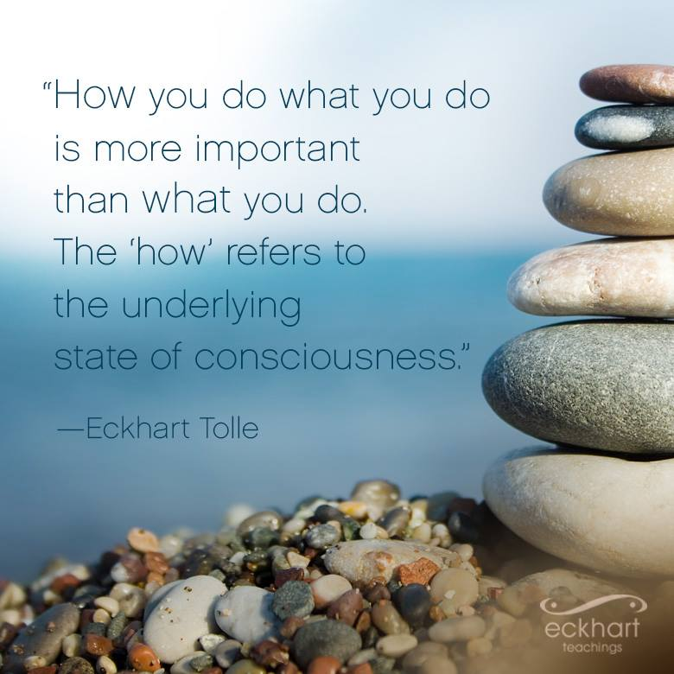

Slide 17
The Theory
Spirituality = the Solution to the Problem

Slide 18
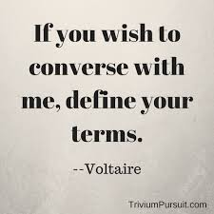
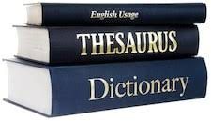
Defining Terms
Spirituality = the Solution to the Problem
Define:
  Spirituality
  Problem
  Solution

Slide 19
Defining Terms
Spirituality = the Solution to the Problem
Define:
  Spirituality
  Problem
  Solution

Slide 20



Defining Terms: Spirituality
What does it mean to you?
If you’re watching this on replay I encourage you to write something down for yourself

Slide 21
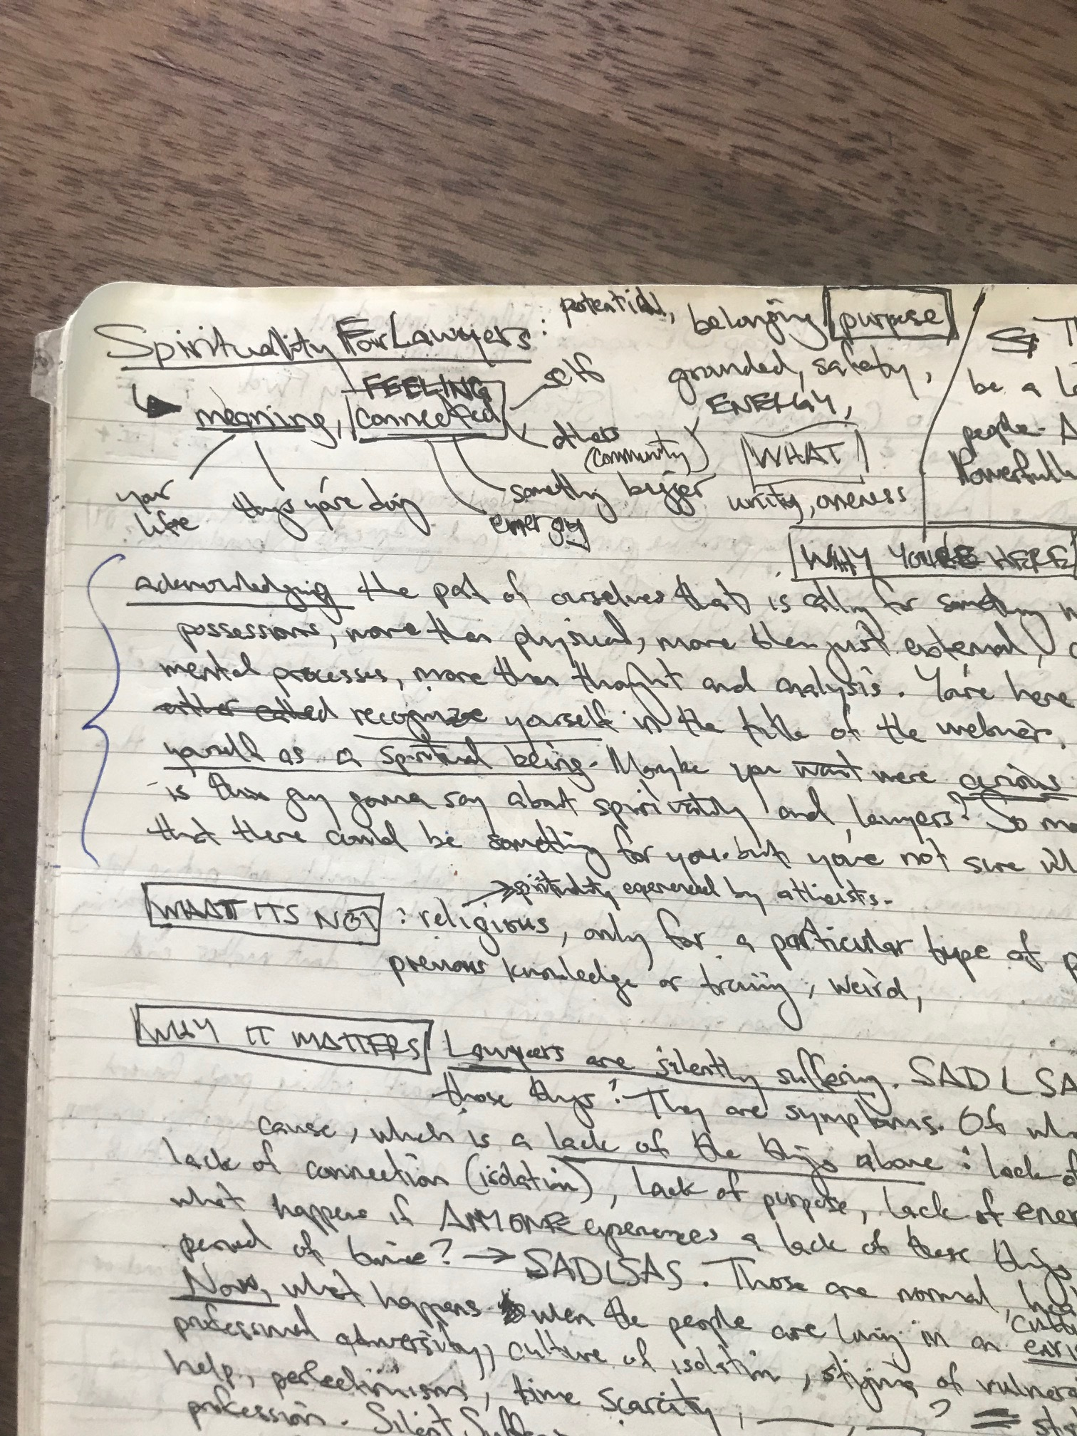
Defining Terms: Spirituality

Slide 22
Defining Terms: Spirituality
    “…the search for transcendent meaning” – can be expressed in religious practice or …expressed ”exclusively in their relationship to nature, music, the arts, a set of philosophical beliefs, or relationships with friends and family”
      Astrow, A., Pulchalski, C., and Sulmasy, D. (2001). Religion, Spirituality, and Health Care: Social, Ethical, and Practical Considerations. American Journal of Medicine. 110:283-287.

Slide 23
Defining Terms: Spirituality
“individual search for meaning”
      Bown, J. and Williams, S. (1993) Spirituality in Nursing: A Review of the Literature. Journal of Advances in Health and Nursing Care. 2(4):41-66.
“a quality that goes beyond religious affiliation, that strives for inspiration, reverence, awe, meaning and purpose, even in those who do not believe in God.”
      Murray, R. and Zentner, J. (1989). Nursing Concepts for Health Promotion. London: Prentice-Hall.

Slide 24
Defining Terms: Spirituality
    “Spirituality is recognizing and celebrating that we are all inextricably connected to each other by a power greater than all of us, and that our connection to that power and to one another is grounded in love and compassion. Practicing spirituality brings a sense of perspective, meaning, and purpose to our lives.”
      Brene Brown, Researcher, Storyteller, Texan

Slide 25
Defining Terms: Spirituality
“Spirituality refers to a broad set of principles that transcend all religions. Spirituality is about the relationship between ourselves and something larger. That something can be the good of the community or the people who are served by your agency or school or with energies greater than ourselves. Spirituality means being in the right relationship with all that is. It is a stance of harmlessness toward all living beings and an understanding of their mutual interdependence.”
      Kaiser, L. (2000). “Spirituality and the Physician Executive: Reconciling the Inner Self and the Business of Health Care. The Physician Executive. 26(2). March/April.

Slide 26
Defining Terms: Spirituality is Not
What is it not, to you?
If you’re watching this on replay I encourage you to write something down for yourself

Slide 27
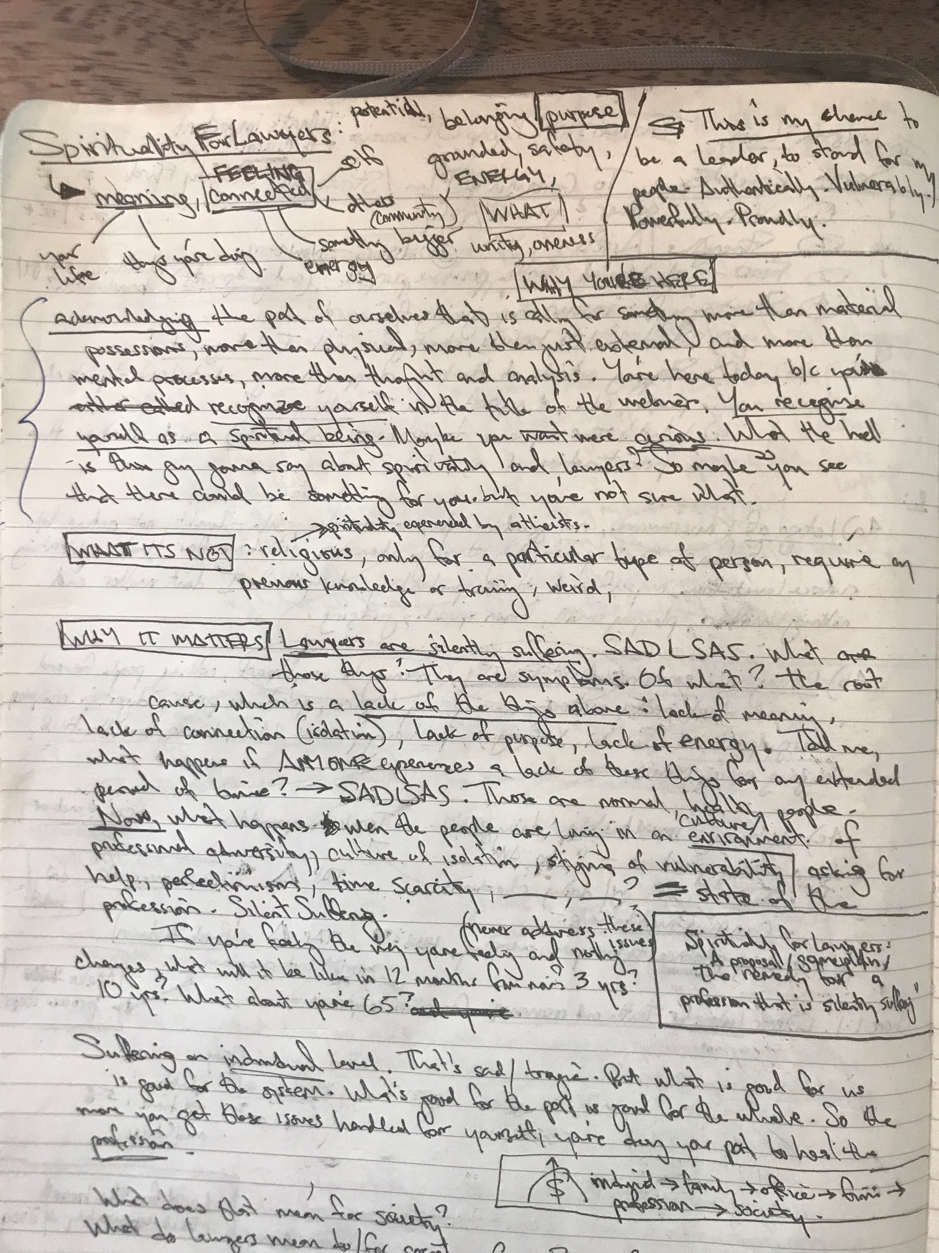
Defining Terms: Spirituality is Not

Slide 28
Defining Terms: Spirituality is Not
“A person can be spiritual without being religious. A person can also be outwardly “religious” in performing certain actions, and yet not focus on the underlying principles of spirituality.”
    Georgetown University’s National Center for Cultural Competence

Slide 29
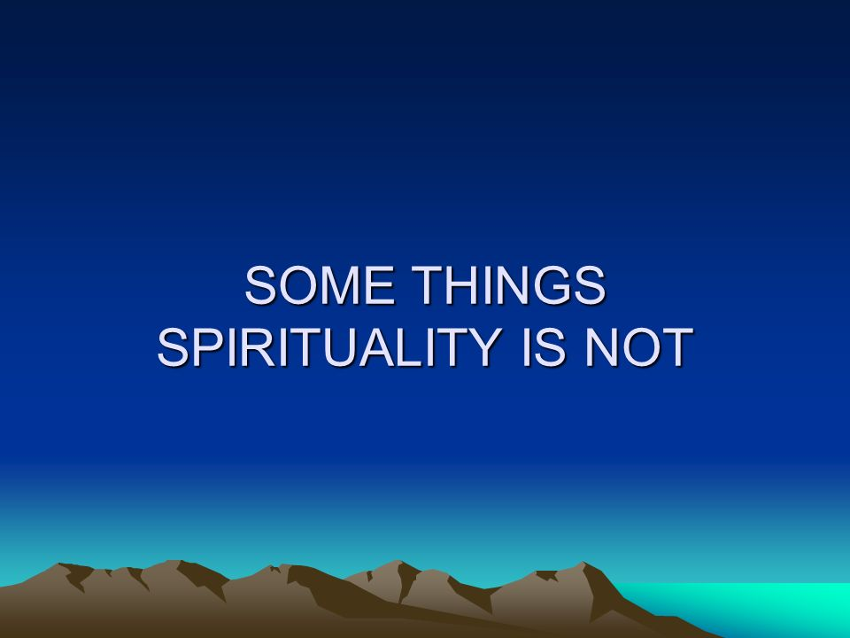
Defining Terms: Spirituality is Not
A fixed set of rules
Based on fear
Someone else’s truth
About separation
    Kasim Khan, The Spirit Science

Slide 30
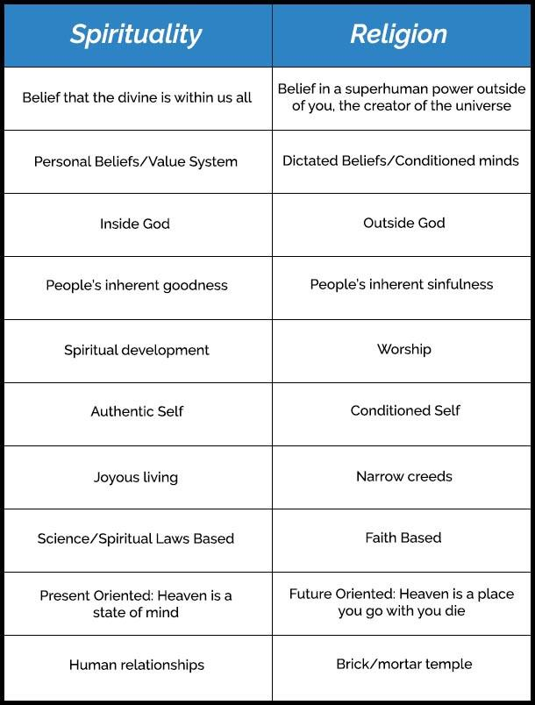
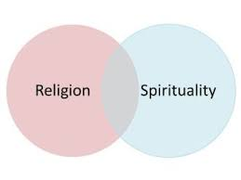
Religion & Spirituality
“Religion is belief in someone else’s experience.
Spirituality is having your own experience.”
– Deepak Chopra

Slide 31
Defining Terms: Spirituality

Slide 32
Defining Terms: Spirituality
    “…the search for transcendent meaning” – can be expressed in religious practice or …expressed ”exclusively in their relationship to nature, music, the arts, a set of philosophical beliefs, or relationships with friends and family”
      Astrow, A., Pulchalski, C., and Sulmasy, D. (2001). Religion, Spirituality, and Health Care: Social, Ethical, and Practical Considerations. American Journal of Medicine. 110:283-287.

Slide 33
Defining Terms: Spirituality
“individual search for meaning”
      Bown, J. and Williams, S. (1993) Spirituality in Nursing: A Review of the Literature. Journal of Advances in Health and Nursing Care. 2(4):41-66.
“a quality that goes beyond religious affiliation, that strives for inspiration, reverence, awe, meaning and purpose, even in those who do not believe in God.”
      Murray, R. and Zentner, J. (1989). Nursing Concepts for Health Promotion. London: Prentice-Hall.

Slide 34
Defining Terms: Spirituality
    “Spirituality is recognizing and celebrating that we are all inextricably connected to each other by a power greater than all of us, and that our connection to that power and to one another is grounded in love and compassion. Practicing spirituality brings a sense of perspective, meaning, and purpose to our lives.”
      Brene Brown, Researcher, Storyteller, Texan

Slide 35
Defining Terms: Spirituality
“Spirituality refers to a broad set of principles that transcend all religions. Spirituality is about the relationship between ourselves and something larger. That something can be the good of the community or the people who are served by your agency or school or with energies greater than ourselves. Spirituality means being in the right relationship with all that is. It is a stance of harmlessness toward all living beings and an understanding of their mutual interdependence.”
      Kaiser, L. (2000). “Spirituality and the Physician Executive: Reconciling the Inner Self and the Business of Health Care. The Physician Executive. 26(2). March/April.

Slide 36
Defining Terms: Spirituality
(Summary)
IS
IS NOT
CONNECTION
  Ourselves
  Others
  Something bigger
PURPOSE
  Meaning
Religious
Exclusive
Dogmatic
Outside of ourselves
Unnatural

Slide 37
Defining Terms: Spirituality
Spirituality = the Solution to the Problem
Define:
  Spirituality = Connection & Purpose
  Problem
  Solution

Slide 38
Defining Terms: Spirituality
Spirituality = the Solution to the Problem
Define:
  Spirituality = Connection & Purpose
  Problem
  Solution

Slide 39
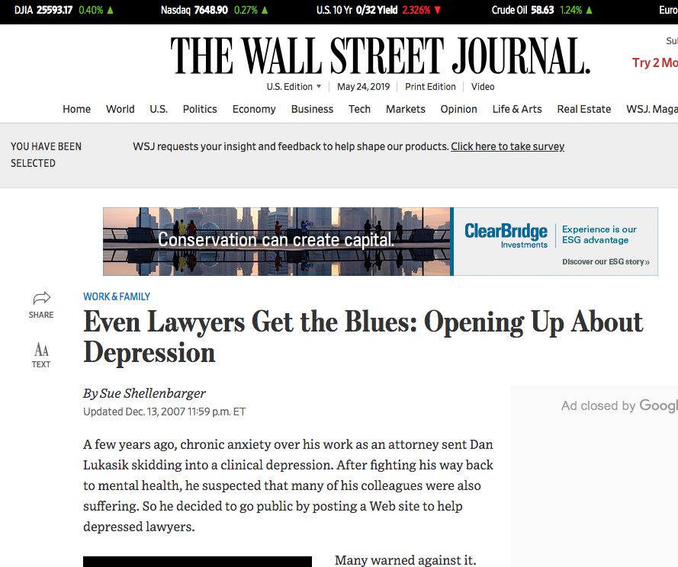

Slide 40
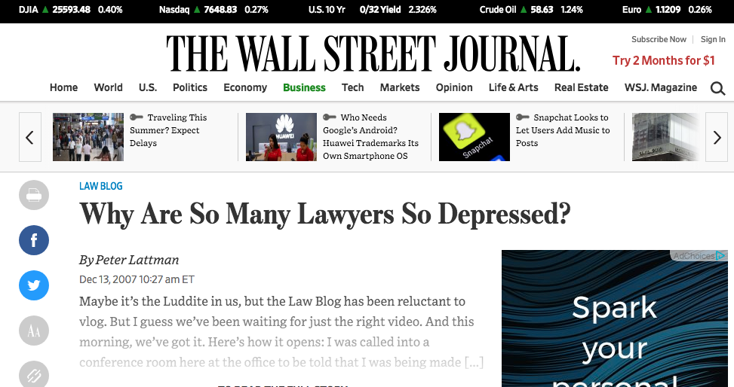

Slide 41
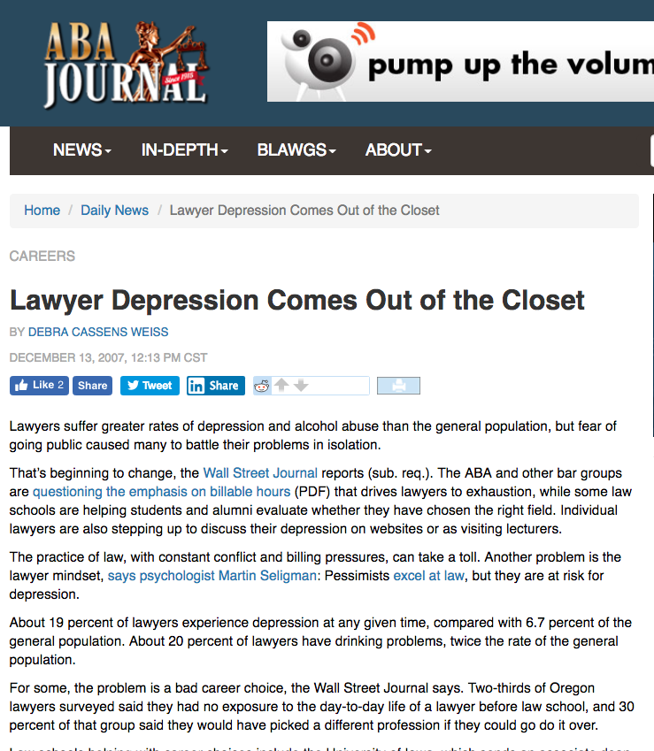

Slide 42
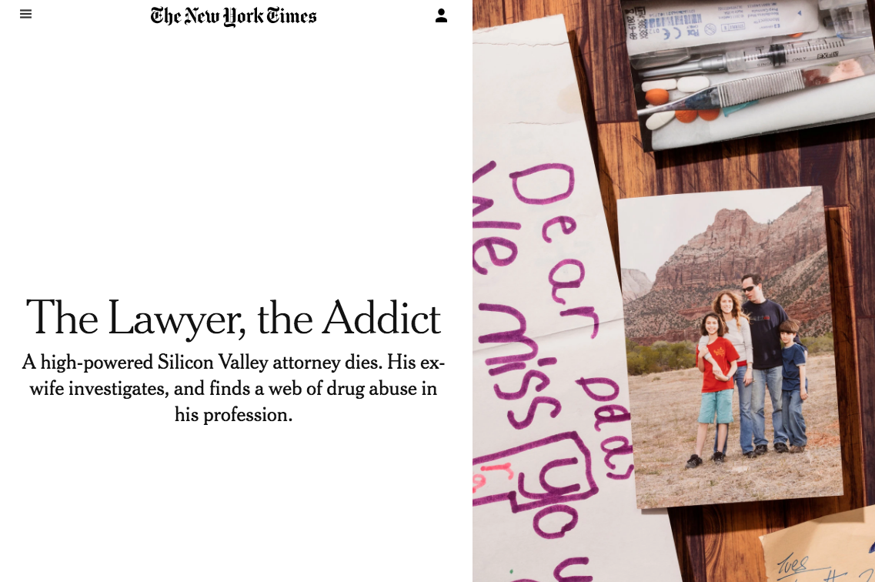

Slide 43
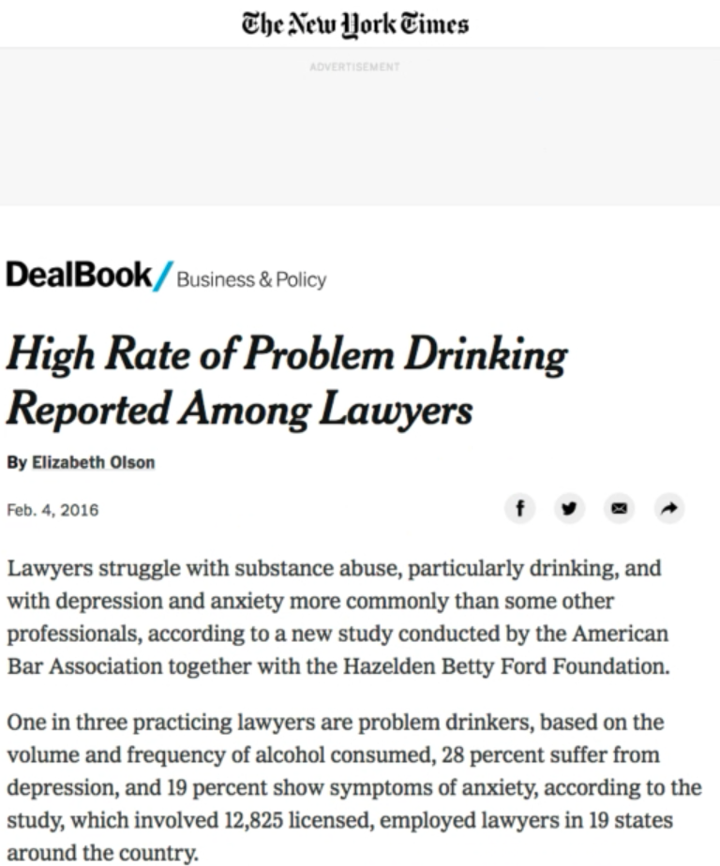

Slide 44
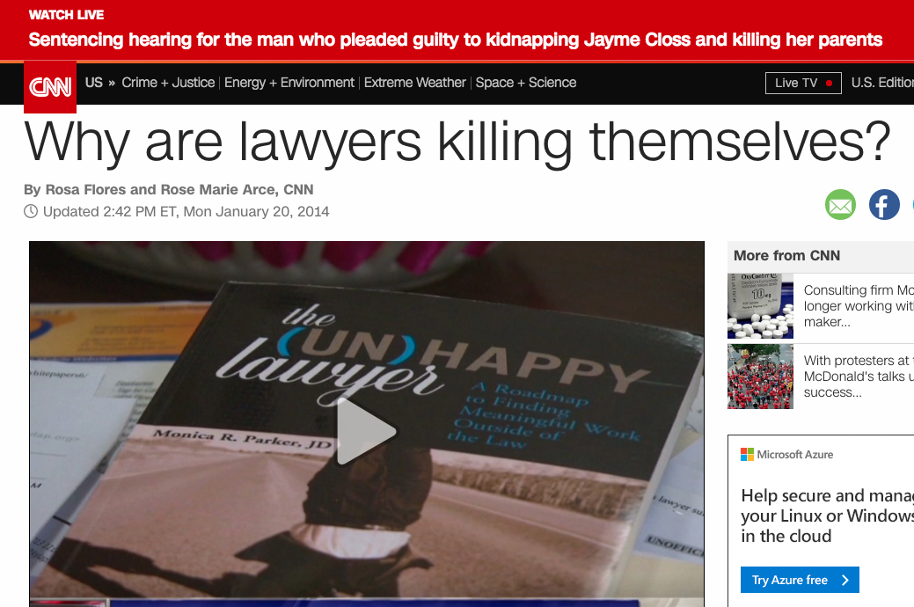

Slide 45
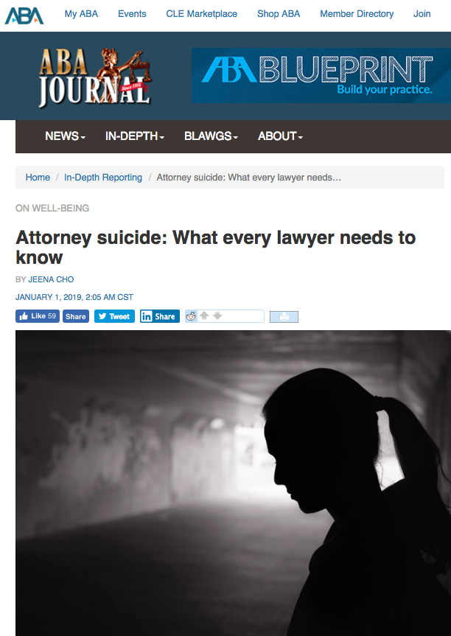

Slide 46

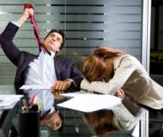


Defining Terms: the Problem?
Depression: 28%
  3.6X > non-lawyers
Anxiety: 19%
Stress: 23%
Sleep Deprivation:
Problematic Drinking
  33% vs. national average 6.8%
Suicide: 2x > non-lawyers

Slide 47


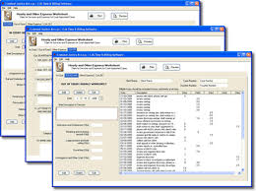
Defining Terms: the Problem
(Aggravating Factors)
Any fact or circumstance that increases the severity or culpability of an act:
Technology
Demanding Clients
Hours-Based System
Adversarial Nature of Profession
Stigma / Norms within the Profession

Slide 48
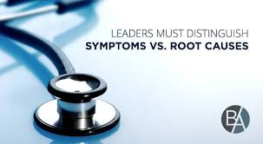
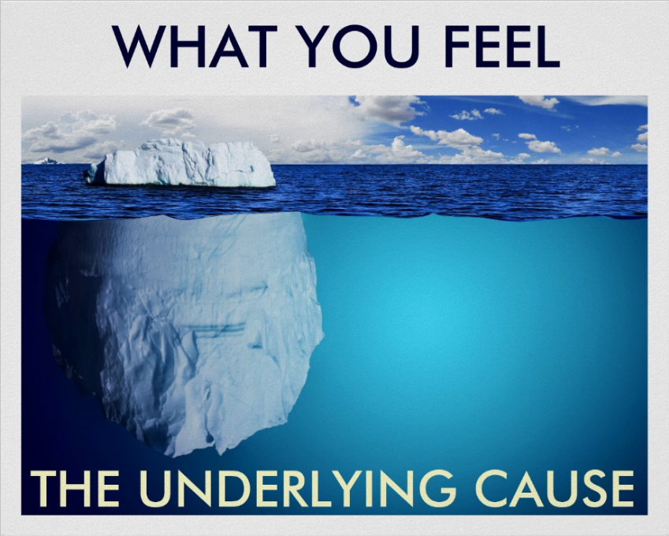
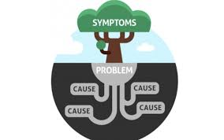
Defining Terms: the Problem
What we talk about as the problem are really symptoms of the root causes
They are not the root causes
So what are the root causes?

Slide 49
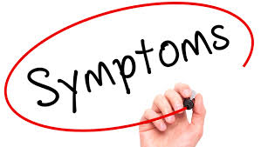
Defining Terms: the Problem?
Depression: 28%
  3.6X > non-lawyers
Anxiety: 19%
Stress: 23%
Sleep Deprivation:
Problematic Drinking
  33% vs. national average 6.8%
Suicide: 2x > non-lawyers

Slide 50
The Real Research Question
What are the root causes, relevant to lawyers, that manifest as the symptoms of stress, anxiety, depression, substance abuse, and suicide?

Slide 51
The Real Research Question
SPOILER ALERT

Slide 52
The Real Research Question
What are the root causes, relevant to lawyers, that manifest as the symptoms of stress, anxiety, depression, substance abuse, and suicide?
#1 – Loneliness & Disconnection
#2 – Lack of Purpose

Slide 53

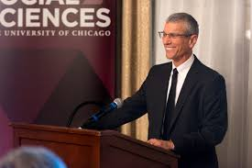
Root Causes of Symptoms:
#1 Loneliness & Disconnection
Loneliness:
  Less satisfied with our lives
  Worldview is more pessimistic
  Increased stress, anxiety, and anger
  Increase in depressive symptoms
Disconnection:
  Higher levels of perceived stress (compared to same stressors as non-lonely people)
  Major precipitant to alcoholism
  Dr. John Cacioppo, Director of the Center for Cognitive & Social Neuroscience

Slide 54
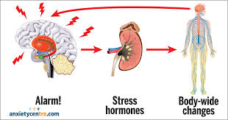
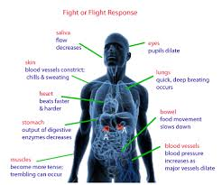
Root Causes of Symptoms:
#1 Loneliness & Disconnection
Loneliness / Disconnection:
  Puts us on high alert
  Triggers body's stress response
Effects brain & body
  Multiple body systems exposed to excess amounts of stress hormones
  Cortisol, adrenaline, norepinephrine
    Heart, lungs, stomach, blood vessels, eyes, skin, etc.
    Hara Estroff Marano, Psychology Today, July 2003

Slide 55
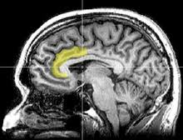
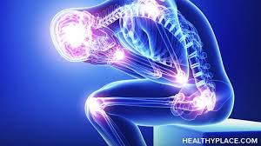
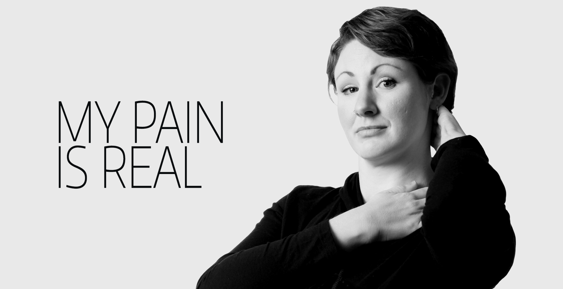
Root Causes of Symptoms:
#1 Loneliness & Disconnection
Lights up the anterior cingulate cortex
This is the exact same area that lights up for the distress of physical pain
Biologically identical to the distress of physical pain

Slide 56



Root Causes of Symptoms:
#1 Loneliness & Disconnection
Why does this happen?
Human beings are social/tribal animals by nature
We evolved to be connected
So,
  Satisfying social relationships are essential for mental and physical well being.
    Mushtaq, R., (2014). Relationship between loneliness, psychiatric disorders and physical health, Journal of Clinical and Diagnostic Research

Slide 57


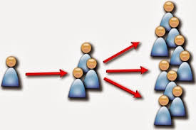
Notes on Loneliness
Psychotherapist is not a substitute for having friends and companions
  Not a rich reciprocal bond
Loneliness is contagious: It spreads in clusters throughout social networks
  Opportunity to break the cycle
It hides in plain sight and, unlike smoking or obesity, isn't typically seen as a threat

Slide 58

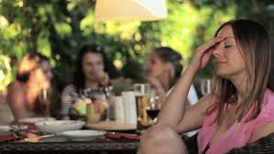
Notes on Loneliness
Subjective analysis (not objective)
“Being with others doesn’t mean you’re going to feel connected, and being alone doesn’t mean you’re going to feel lonely.”
What matters is whether you feel emotionally or socially disconnected from others.
It’s about interpretation, the meaning we assign to the situation, and what we tell ourselves about what is happening.

Slide 59
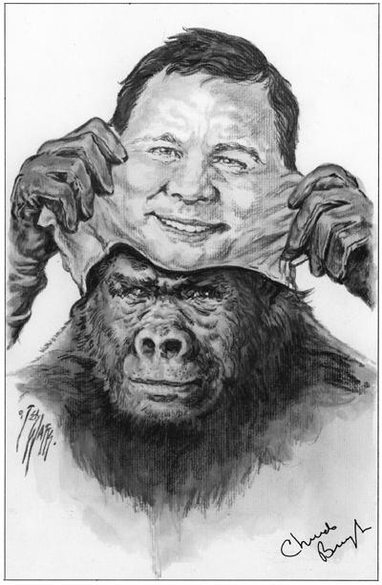

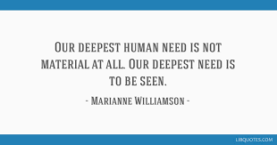
Notes on Loneliness
Authenticity:
  Crucial to have a few true confidants you can be your true self with
Vulnerability:
  Uncertainty, risk and emotional exposure is the birthplace of love, belonging, joy, courage, empathy and creativity (B. Brown)

Slide 60
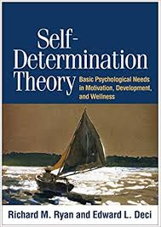
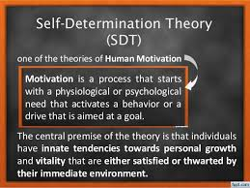

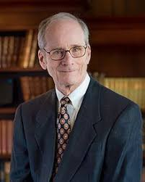
Root Causes of Symptoms:
#2 Lack of Purpose
Dr. Edward L. Deci, Founder of self-determination theory (SDT) theory

Slide 61
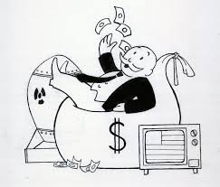

Root Causes of Symptoms:
#2 Lack of Purpose
External Motivation
  Money
  Fame
  Status
  Beauty
Internal Motivation
  Relationships
  Personal Growth
  Community
  Purpose

Slide 62

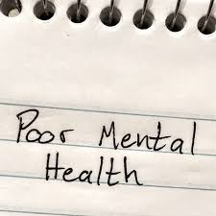

Root Causes of Symptoms:
#2 Lack of Purpose
“Having an unusually strong aspiration for material success was associated with narcissism, anxiety, depression, and poorer social functioning”
Edward Deci
Extrinsic Motivation

Slide 63


Root Causes of Symptoms:
#2 Lack of Purpose
External Motivation
  Money
  Fame
  Status
  Beauty
Internal Motivation
  Relationships
  Personal Growth
  Community
  Purpose

Slide 64
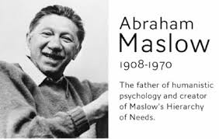
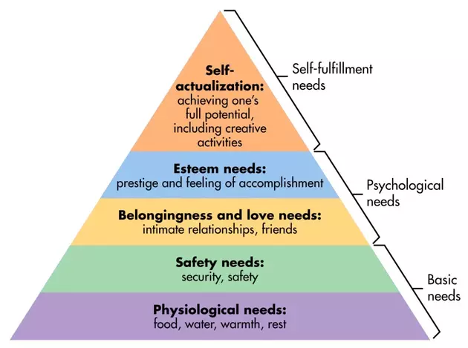


Root Causes of Symptoms:
#2 Lack of Purpose
Aligns with Maslow’s theories
Self-Actualization (you’re here…)
  Highest need
    Not a “nice to have”
  Oxygen for the soul
  “What humans can be, they must be”

Slide 65

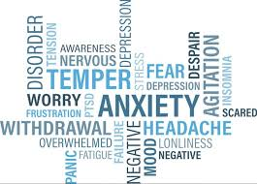
Root Causes of Symptoms:
#2 Lack of Purpose
Self-Actualization = Pursuing Purpose =
  Realizing personal potential, self-fulfillment, seeking personal growth
Integrity Gap: (close the gap)
}
Your Potential
Actual

Slide 66



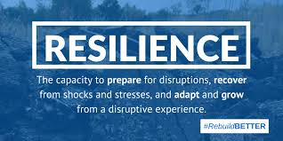
Root Causes of Symptoms:
#2 Lack of Purpose
How Purpose helps:
  A guiding light when it’s dark
  A protective shield against stressors that might negatively affect our health
Stressors are perceived as less threatening, and therefore are less harmful
You are clear on who you are, what you’re doing, why it matters, etc.

Slide 67
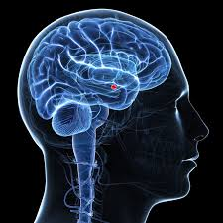
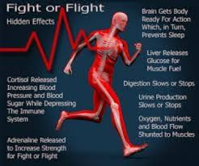
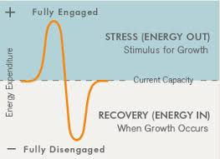
Root Causes of Symptoms:
#2 Lack of Purpose
Regulates the amygdala (a brain region involved in fear, anxiety-related processes & fight-or-flight)
Faster recovery from stress and trauma
  Maintains psychological and physical homeostasis (return to center) faster

Slide 68



Root Causes of Symptoms:
#2 Lack of Purpose
Purpose & Work
72% of Americans do not possess a sense of purpose at work.
Aaron Hurst, The Purpose Economy
Yet, we spend a majority of our waking hours working/at work

Slide 69


Root Causes of Symptoms:
#2 Lack of Purpose
Impact of Purpose at Work:
  Deepen Relationships (Connection)
  Feel Your Work Matters
  Growth as a Human Being
Do you find purpose in your work?
  You create the meaning

Slide 70



Notes on Purpose
First, uncover/clarify your Purpose
Second, align with your Purpose
  Based on Your Values
  Short & Long Term
  Personal & Professional
the state of being whole and undivided

Slide 71




Notes on Purpose
Additional Benefits of Purpose:
Increased longevity
Slowed effects of aging
Higher levels of psychological well-being
… Regardless of when you find your purpose

Slide 72
Defining Terms: Spirituality
Spirituality = the Solution to the Problem
Define:
  Spirituality = Connection & Purpose
  Problem = Disconnection & Lack of Purpose
  Solution

Slide 73
Defining Terms: Solution
Spirituality = the Solution to the Problem
Define:
  Spirituality = Connection & Purpose
  Problem = Disconnection & Lack of Purpose
  Solution

Slide 74



Defining Terms: Solution
Solution:
  “A means of solving a problem or dealing with a difficult situation.”
  “An answer to a problem”

Slide 75

Defining Terms: Solution
Spirituality = the Solution to the Problem
Putting it Together: Our Definitions:
  Problem = Disconnection & Lack of Purpose
  Spirituality = Connection & Purpose
  Solution = An answer to a Problem
So, Spirituality [Connection & Purpose] = the Solution [answer] to
[Disconnection & Lack of Purpose]

Slide 76

The Theory (Restated)
Theory: Spirituality is the Solution to the Problem
“Connection with ourselves, others, and something bigger than ourselves, as well as an authentic and aligned sense of purpose in our lives, is the missing key to solving the epidemic of stress, anxiety, depression, substance abuse, and suicide that is plaguing our nation’s lawyers.”

Slide 77
The Impact

Slide 78




What’s the Impact
For you
  Without connection & purpose
  With connection & purpose
For those around you: family, clients, colleagues, etc.
  Without connection & purpose
  With connection & purpose

Slide 79
Tools & Strategies

Slide 80



Tools & Strategies
Self Awareness is the FIRST STEP
  Breathing Practices
  Meditation
  Mindfulness / Presence / Awareness practices / Meta-Cognition
  Self-Reflection / Focus Inward on Yourself
  Visualization
  Prayer
  Yoga

Slide 81

Tools & Strategies
Connection: just a little bit more
  To yourself: choose a practice from the list
  To others: share authentically & vulnerably
  To something bigger than yourself: what does this mean to you?
Purpose: decide, commit to:
  Self-actualization
  Realize your true potential
  It’s a process, a journey
  Find the overlap of your gifts & strengths, passions, and a sense of service

Slide 82




Tools & Strategies
  Take care of your body & mind
  Read inspirational & spiritual material
  Generosity
    Self & others
  Forgiveness & Acceptance
  De-clutter & simplify your life
  Spend time in nature
  Journaling
  …

Slide 83


Conclusion
The selection of tools is endless…
Anything you do can be a spiritual practice
    BEING > DOING
    HOW > WHAT
Remember it’s a CHOICE that you make moment-to-moment-to-moment

Slide 84

support@samirghia.com
Questions from today
Coaching 1:1
Consulting
Speaking

